Slide 1
Electronics STORE trends in International Markets
Contoso Electronics

Slide 2
Current trends
Clean/minamilstic
Creative use of type
Fresh use of color

Slide 3
Project scope
Use Branding for Continuity
Convey Benefits of the New Release
Improve on the Past
Not Just More of the Same
Notes:
Develop a strategy for our product lines that reaches customers effectively in both physical and virtual environments.
Integrate brand pillars for customer recognition and continuity.
Convey the proof behind the value props with customer success stories.
Minimize thrash with updates to sales tools at close of each quarter.
Implement effective follow-ups to capture success and failure key takeaways.

Slide 4

Project team

Slide 5
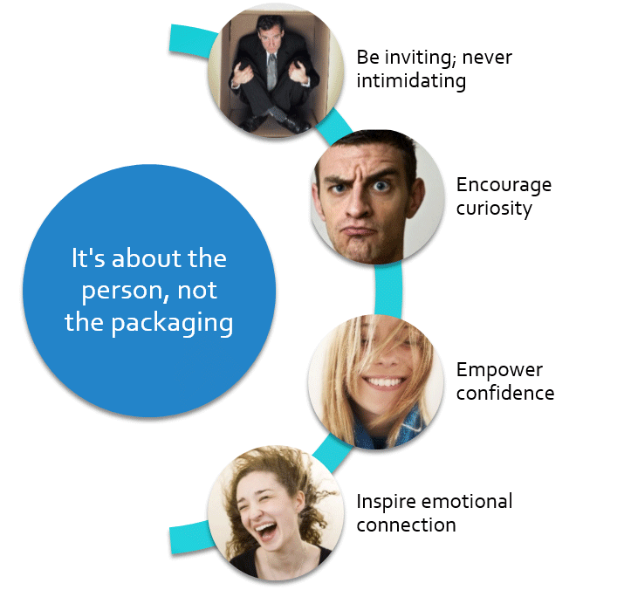
Fit the person—not the Box

Slide 6

Emotional Connection
Emotional connection is key
The right connection inspires brand loyalty
It’s time to break new ground
Notes:
Emotional connection is key
Research shows that virtually all strong opinions on packaging for our products and those of competitors are emotion-based
The right connection inspires brand loyalty
Change brand perception by getting personal
It’s about the person, not the package
Breaking new ground
Every aspect of the package should have a purpose
We need to get better about making choices

Slide 7
Design considerations
What Creates a Connection?
Notes:
What attracts the person to the package?
Shape and color were the clear winners in focus group testing

